Slide 1
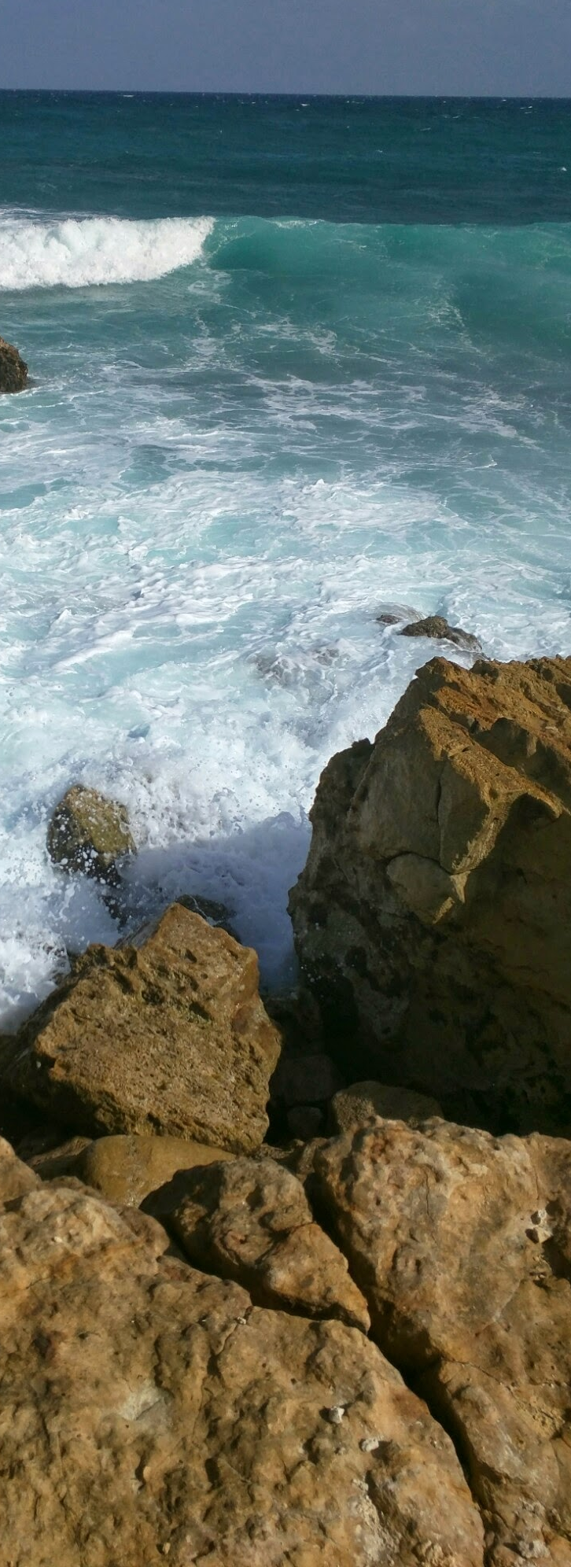


Impulse Business Growth Success
Bicycle Rental
Aldo Rene Fernandez Hernandez.

Slide 2
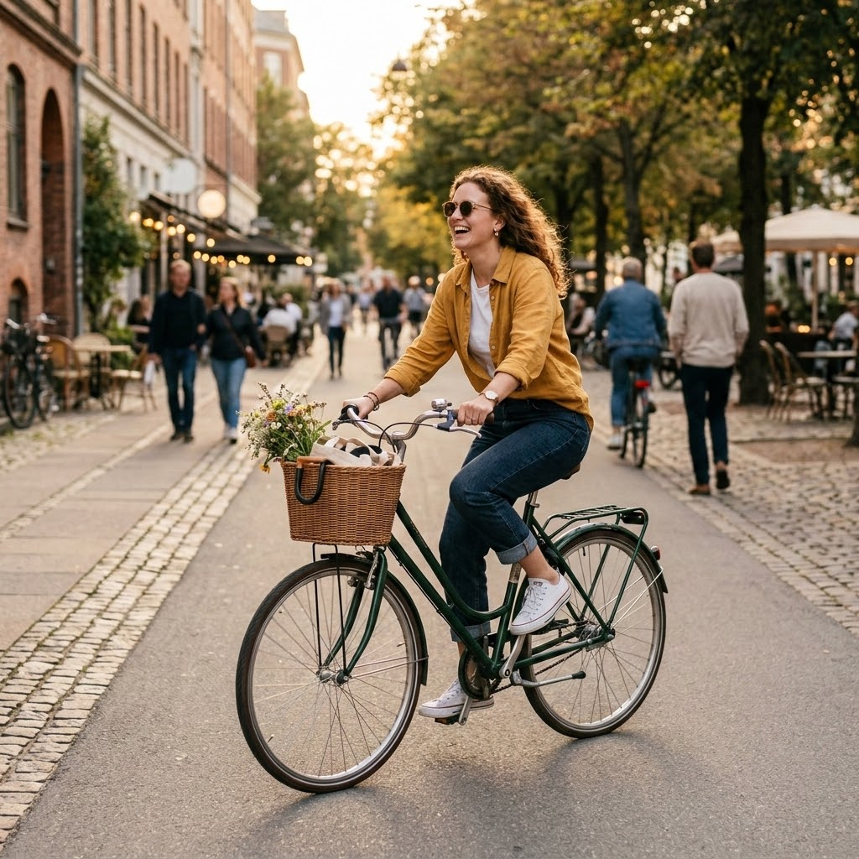
Business objective
Impulse future business growth through the design of a new marketing strategy to convert casual riders into annual members.

Slide 3

Data source and resources used
Divvy-tripdata 2020-2021 (Cyclistic trip data) Org. Data
Capital Bikeshare (Washington D.C.) Intercept Survey (2017)
Tableau Visualization: Chicago Cyclist Ride Rental Insights
By Aldo Fernandez Hernandez

Slide 4
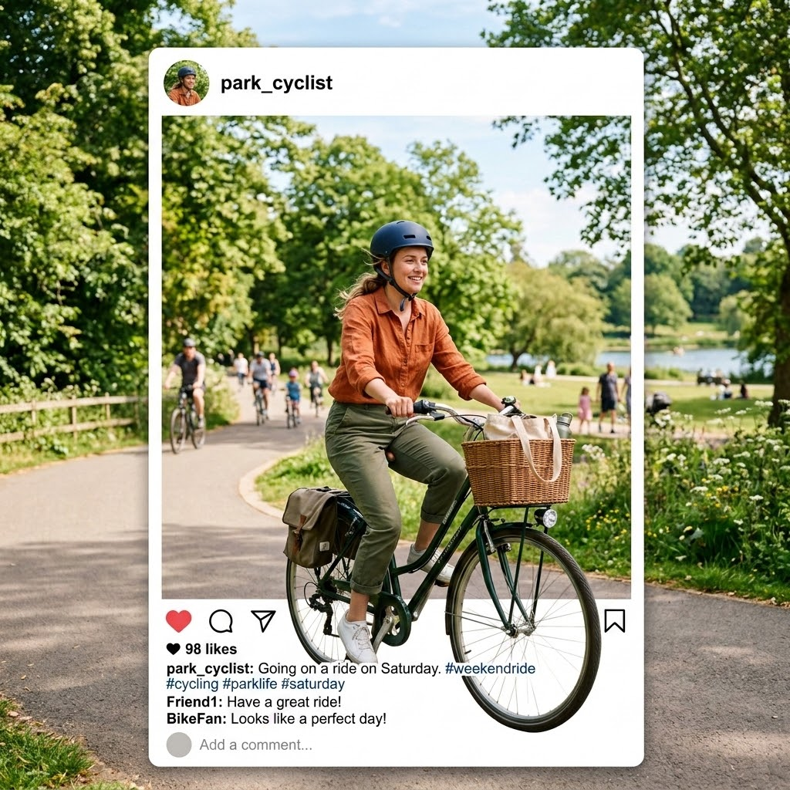
Analysis summary
Members make up the majority of riders (59.1%), while casual riders account for 40.9%.
Casual riders consistently take much longer rides than members across every day of the week. Their average ride length stays high (roughly 1,600–3,000 seconds), peaking near 2,764 seconds on Saturday. Members’ average ride lengths are substantially shorter (around 900–1,100 seconds most days) and show a similar mid-week dip.
These patterns suggest casual riders use the service more for leisure or longer recreational trips, especially on weekends, while members tend toward shorter, more routine rides. A marketing strategy aimed at converting casual riders could highlight the value of membership for frequent longer trips and weekend usage.

Slide 5
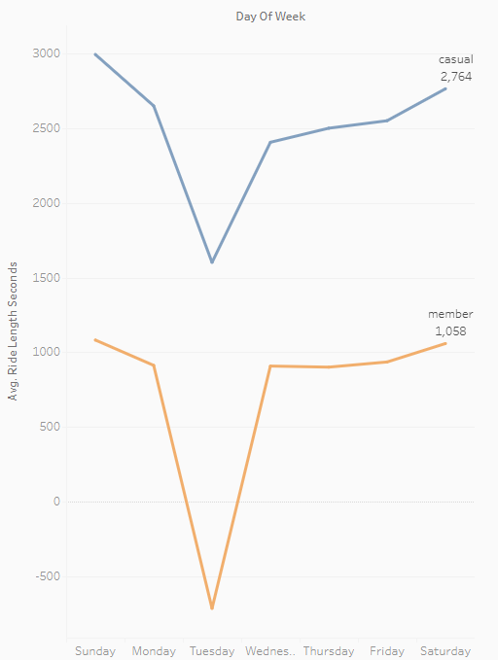
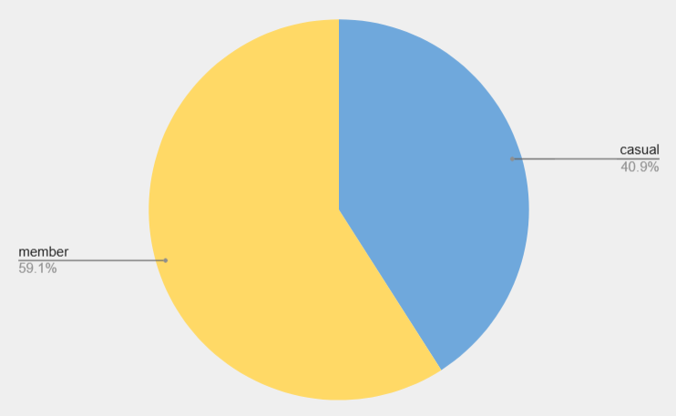
Visualizations and findings
Members are 59% of riders; casuals 41%. Casuals ride much longer (esp. weekends) than members. Target weekend leisure riders with membership offers.

Slide 6
Top 3 Marketing strategies based on findings
Launch a “Weekend Explorer” membership campaign
Target casual riders with offers that highlight unlimited long rides on Saturdays and Sundays (when their usage peaks). Use messaging like “Turn your long weekend rides into unlimited freedom” and promote a limited-time discount or free trial week focused on leisure users.
Create a “Ride Longer, Save More” conversion offer (Strong Strategy)
Since casuals already take significantly longer rides than members, position annual membership as the smarter financial choice for frequent long-distance users. Calculate and show potential savings based on their typical ride lengths and push this via in-app prompts after longer rides.
Run mid-week re-engagement + weekend upsell sequences
Both groups dip mid-week (especially Tuesday). Use this quieter period to send personalized emails/SMS to casual riders: “Miss the long rides? Upgrade now and ride unlimited all week.” Follow up with strong weekend reminders to convert them before their high-usage days.

Slide 7
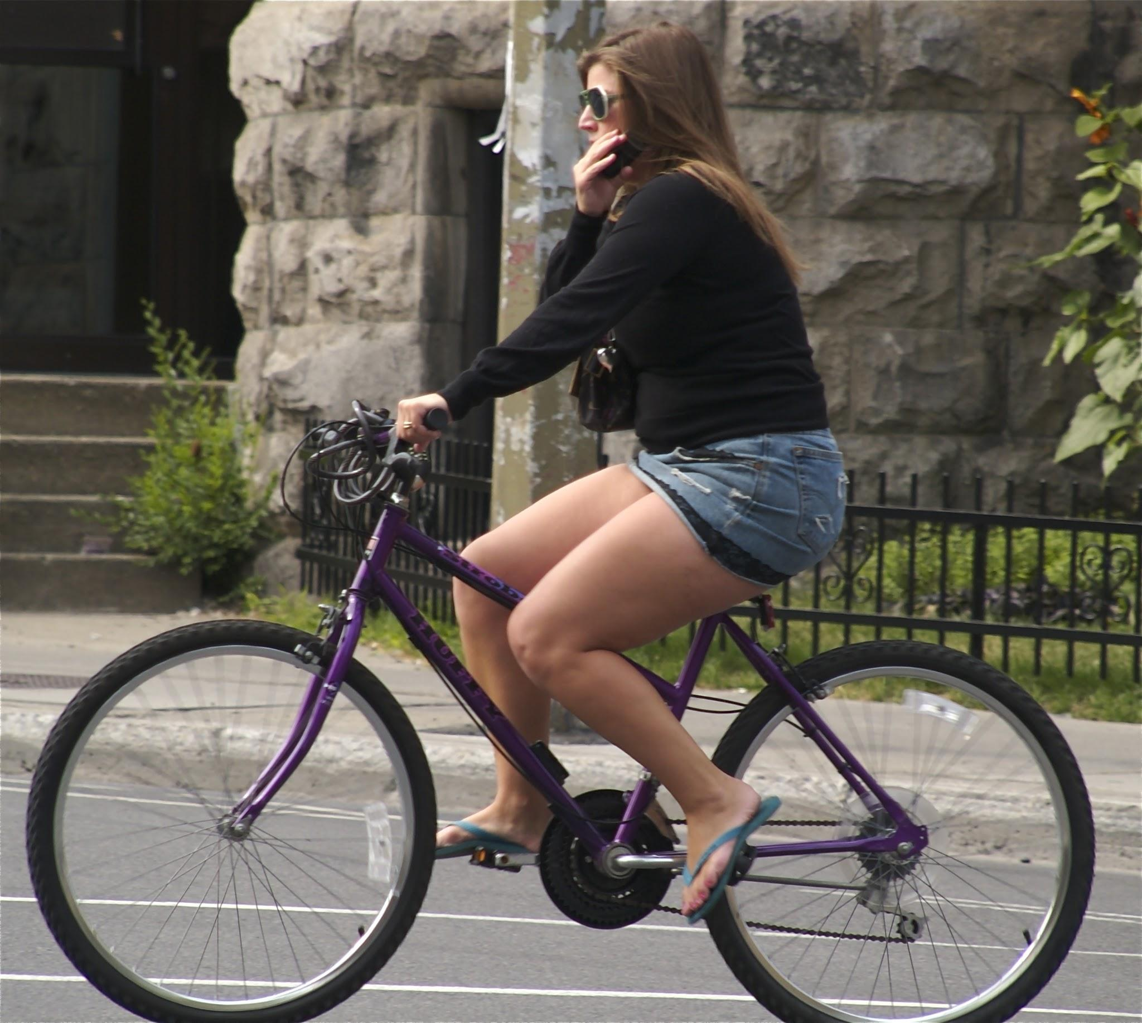
Key Takeaways
Membership mix: Members make up 59.1% of riders; casuals are 40.9%.
Usage pattern: Casual riders take significantly longer rides than members on every day of the week, with the biggest gap and peak usage on weekends (especially Saturday).
Opportunity: Casuals already show high leisure/long-ride behavior — the main barrier is converting that occasional heavy use into committed annual membership.

